Slide 1
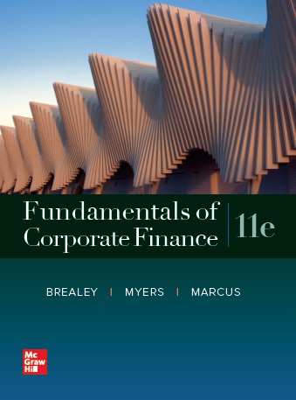
Fundamentals of Corporate Finance, 11th Edition
CHAPTER 6: Valuing Bonds
© McGraw Hill LLC. All rights reserved. No reproduction or distribution without the prior written consent of McGraw Hill LLC.

Slide 2
Model for r_{C}
r_{C} = Risk-Free Rate + Maturity Risk Premium + Default Risk Premium
r_{C} = r_{f} + r_{mp} + r_{dp}

Slide 3
Default Risk
Moody' s | Standard & Poor's | Safety
Aaa | AAA | The strongest rating; ability to repay interest and principal is very strong
Aa | AA | Very strong likelihood that interest and principal will be repaid
A | A | Strong ability to repay, but some vulnerability to changes in circumstances
Baa | BBB | Adequate capacity to repay; more vulnerability to changes in economic circumstances
Ba | BB | Considerable uncertainty about ability to repay
B | B | Likelihood of interest and principal payments over sustained periods is questionable
Caa | CCC | Bonds in the Caa/CCC and Ca/CC classes may already be in default or in danger of imminent default
Ca | CC
C | C | C-rated bonds offer little prospect for interest or principal on the debt ever to be repaid

Slide 4
Ratings
What affects the Rating? What do the Ratings Agencies review?
-Quality of the Company
-State of the Economy
-Bond-specific issues such as:
-Are there strong financial covenants in the Bond contract?
-Is there collateral supporting the debt? Is the collateral of value?
-Are the bonds senior or junior to other debt? Are the bonds “subordinated” to other debt?

Slide 5
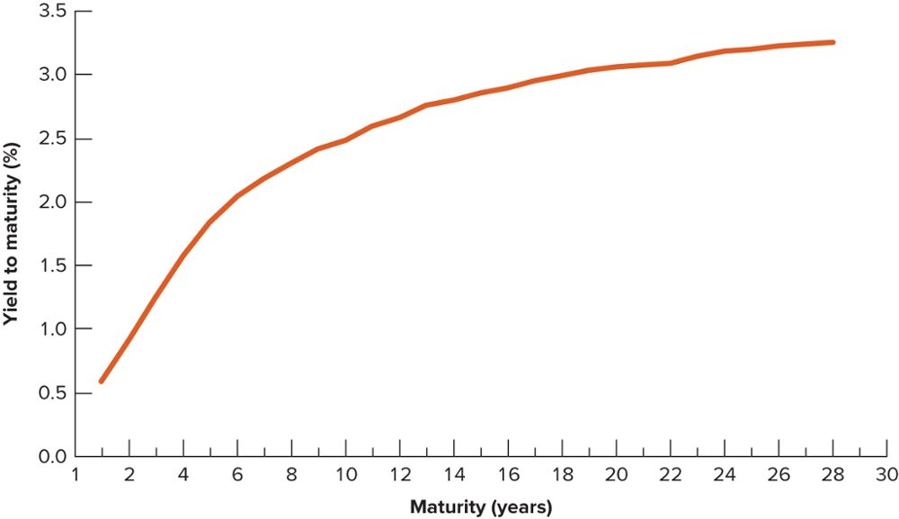
The Yield Curve
Treasury securities and Corporate debt securities, YTM returns plotted against maturity

Slide 6
Bond Table (from the Market)
Security | Maturity | Coupon Rate | Face Value | Price | YTM
Treasury Bill | 1 year | 0.00% | $1,000 | $994.53 | ?
Treasury Note | 5-year | 2.00% | $1,000 | $1,009.48 | ?
Corp. X (BBB) | 5-year | 2.80% | $1,000 | $979.54 | ?
Treasury Bond | 10-year | 2.30% | $1,000 | $986.84 | ?
Corp. Y (AA) | 10-year | 3.25% | $1,000 | $1,012.73 | ?
Treasury Bond | 18-year | 2.75% | $1,000 | $979.19 | ?
Corp. Z (A) | 18-year | 3.50% | $1,000 | $955.15 | ?

Slide 7
Calculate YTM
Examples: using RATE function
5-year Treasury
5 NPER 20 PMT -1,009.48 PV 1,000 FV
18-year Corporate
18 NPER 35 PMT -955.15 PV 1,000 FV

Slide 8
Bond Table (from the Market)
Security | Maturity | Coupon Rate | Face Value | Price | YTM
Treasury Bill | 1 year | 0.00% | $1,000 | $994.53 | 0.55%
Treasury Note | 5-year | 2.00% | $1,000 | $1,009.48 | 1.80%
Corp. X (BBB) | 5-year | 2.80% | $1,000 | $979.54 | 3.25%
Treasury Bond | 10-year | 2.30% | $1,000 | $986.84 | 2.45%
Corp. Y (AA) | 10-year | 3.25% | $1,000 | $1,012.73 | 3.10%
Treasury Bond | 18-year | 2.75% | $1,000 | $979.19 | 2.90%
Corp. Z (A) | 18-year | 3.50% | $1,000 | $955.15 | 3.85%

Slide 9
Calculate Maturity Risk Premiums
Compare Treasury yields to Risk-Free Rate
5-year: 1.80 – 0.55 = 1.25 =
5-year Maturity Risk Premium
10-year: 2.45 – 0.55 = 1.90 =
10-year Maturity Risk Premium
18-year: 2.90 – 0.55 = 2.35 =
18-year Maturity Risk Premium

Slide 10
Calculate Default Risk Premiums
Compare Corporate yields to Treasury yields of same maturity
5-year Corp X vs. 5-year Treasury:
3.25 – 1.80 = 1.45 =
BBB Default Risk Premium
10-year Corp Y vs. 10-year Treasury:
3.10 – 2.45 = 0.65 =
AA Default Risk Premium
18-year Corp Z vs. 18-year Treasury:
3.85 – 2.90 = 0.95 =
A Default Risk Premium

Slide 11
Summary of Bond Market analysis
 | r_{f} | r_{mp} | r_{dp}
Risk-free Rate | 0.55%
5-yr Maturity Risk Premium |  | 1.25%
10-yr Maturity Risk Premium |  | 1.90%
18-year Maturity Risk Premium |  | 2.35%
AA Default Risk Premium |  |  | 0.65%
A Default Risk Premium |  |  | 0.95%
BBB Default Risk Premium |  |  | 1.45%

Slide 12
Apply your model to your investments
r_{C} = r_{f} + r_{mp} + r_{dp}
You are considering investing in a 10-year A-rated Bond with a Face Value of $1,000 and a Coupon Rate of 3.15%. What price should you pay for the Bond?
(NOTE: in your table, you do not have a 10-year A Bond, but it does not matter because you have all the components)

Slide 13
From your Market analysis
r_{C} = r_{f} + r_{mp} + r_{dp}
r _{10, A} = 0.55 + 1.90 + 0.95 = 3.40%
What price would you pay for the Bond so that you earn r = 3.40%?
PV function
.034 RATE 10 NPER 31.50 PMT 1000 FV
$979.10

Slide 14
Market Theory Supply & Demand
What should you do if the Market Price (P₀) is $985? What will other investors do?
What should you do if the Market Price (P₀) is $975? What will other investors do?

Slide 15
Investment Analysis
You can do same analysis if you calculate the YTMs from above prices and compare to r.
RATE function
10 NPER 31.50 PMT -985 PV 1000 FV
Implied return is 3.33%, but r = 3.40%
Bond is overpriced at $985

Slide 16
Investment Analysis
10 NPER 31.50 PMT -975 PV 1000 FV
Implied return is 3.45%, but r = 3.40%
Bond is underpriced at $975

Slide 17
Downgrade?
What would happen to the price ($979.10) of the bond if that A-rated bond was downgraded to a BBB?
The difference in r_{dp} from A to BBB is 1.45 - .95 = .50, so r would increase from 3.40% to 3.90% and price would drop to
.0390 RATE 10 NPER 31.50 PMT 1000 FV
$938.86

